Slide 1
Arabic Handwritten Recognition Using CNN
Bootcamp T5 Project
By Anwar Aljohani

Slide 2
Introducation
Why handwritten Arabic OCR?
• The Arabic alphabet is also used to script other languages
such as Farsi, Kurd, Persian, Urdu, etc.
• Little research has been addresses in the Arabic OCR.
Handwritten OCR has a wide range of applications: invoice receipt processing, subscription collection,

Slide 3
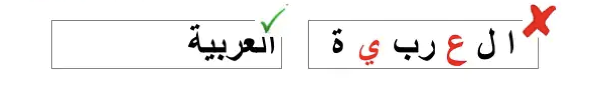

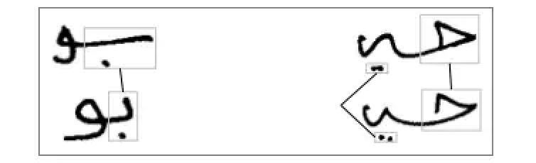
Characteristics of the Arabic language
Arabic is cursive
Arabic letter shapes are context dependent
Variability of letter shapes (in handwritings)

Slide 4
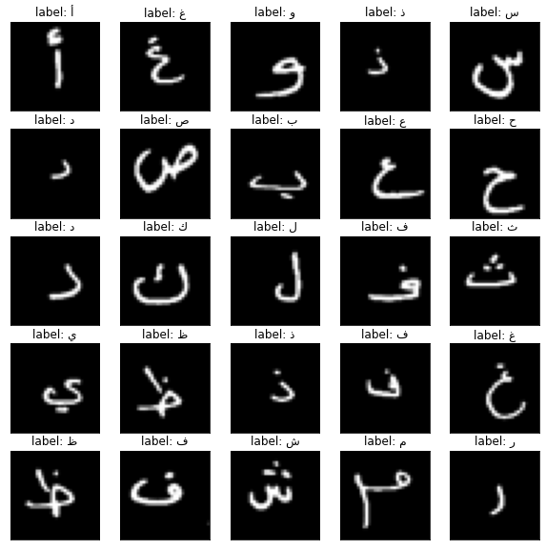

Slide 5
Convolutional Neural Network (CNN)
• Very Popular:
-Toolboxes: tensorflow, cuda-convnet and caffe (user friendlier)
A high performance Classifier (multi-class)
Successful in object recognition, handwritten optical character OCR recognition, image noise removal etc.
Easy to implementation
-Slow in learning
-Fast in classification

Slide 6
Why CNN
Traditional optical character recognition (OCR) systems lacked efﬁciency, as character features were hard-coded and used to match characters. On the other hand, neural networks are able to learn features by analysing a dataset, alleviating the need for manual hard coding of features. At the end of the training process, the neural network learns parameters, making it more ﬂexible when handwriting styles are changed. The creation of the Modiﬁed National

Slide 7
Data
Arabic Letters Dataset is composed of 16,800 characters written by 60 participants, and 90% of participants are right-hand. Each participant wrote each character (from ’alef’ to ’yeh’) ten times.

Slide 8
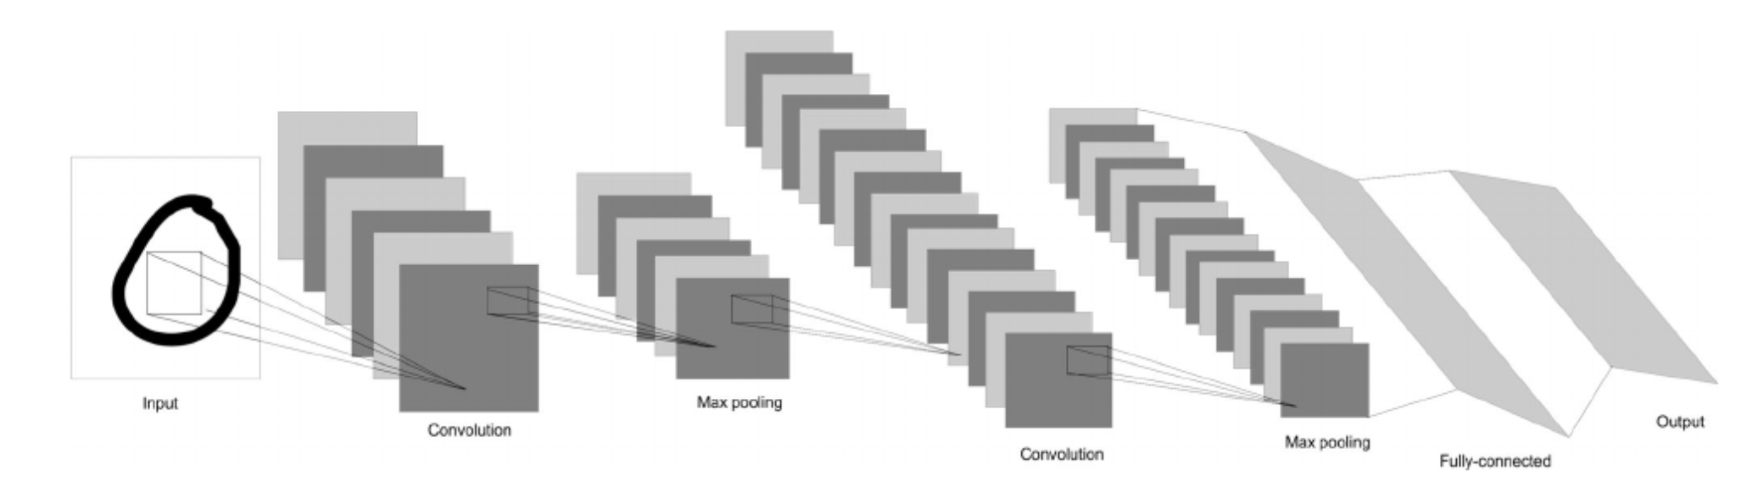
CNN Workflow

Slide 9
Methodology
1- Data Preprocessing
Image Normalization : between 0–1 without loss of information.
Data normalization is an important step which ensures that each input parameter (pixel, in this case) has a similar data distribution. This makes convergence faster while training the network.
Reshape the data to ensure that the input data to the model is in the correct shape.
Keras CNNs require a 4D array as input, with shape (nb_samples,rows,columns,channels)

Slide 10
Methodology
2- Encoding Categorical Labels
From the labels csv files we can see that labels are categorical values and it is a multi-class classification problem.
One-hot encoding transforms integer to a binary matrix where the array contains only one ‘1’ and the rest elements are ‘0’.

Slide 11
Methodology
3- Model Architecture
Model Summary And Visualization
Parameters Tuning
Training the Model
Test the Model

Slide 12
Methodology
Optimizer:
RMSprop ,Adam
Adagrad , Nadam
kernel_initializer
Normal,uniform
Activation
Relu ,Linear, tanh
24 of different possible parameters

Slide 13
Results
Optimizer: RMSprop , kernel_initializer: uniform , activation: linear
Loss: 0.7705
Accuracy: 0.7382
val_loss: 0.3556
val_accuracy: 0.8833
Optimizer: Adam, kernel_initializer: uniform , activation: relu
loss: 0.7203
Accuracy: 0.7578
val_loss: 0.4107
val_accuracy: 0.8705

Slide 14
Results
Optimizer: Adagrad , kernel_initializer: uniform , activation: tanh
loss: 3.3758
accuracy: 0.1000
val_loss: 2.7361
val_accuracy: 0.1852
Optimizer: Nadam, kernel_initializer: normal, activation: relu
loss: 0.7634
accuracy: 0.7404
val_loss: 0.4217
val_accuracy: 0.8577

Slide 15
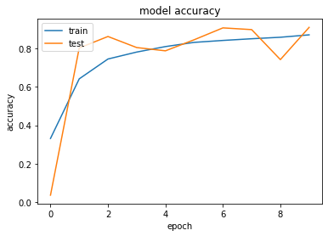
Results
Optimizer: RMSprop
Kernel_initializer: uniform
Activation: linear
Accuracy: 91%

